Slide 1
MEMORY GAME
Name: Aditya Dalwadi
Roll No. : 131 Batch: A4
EnrollmentNo : 21002170110018
Branch: CE

Slide 2
Introduction:
A memory game is created where the user has to match pairs of cards with identical colors.
The cards changes their background color on clicking by assigning the color name and color id.
The game starts with all the cards face down and players take turns to turn over two cards.
If the two cards have the same color, then the cards disappears the cards, otherwise the cards face down again.
When all the card disappears user win’s the game.

Slide 3
How To Play:
In the beginning, You will be able to see a 4x4 grid (total 16) of cards faced down.
Each card has a color on the other side which appears on clicking on the card.
There are total 2 cards of same color, so after clicking(opening) two cards it will match whether both the cards are having same color or not.
If both the cards have same color they will vanish.
Else they will turn down again.
Just remember the position of colors and match them as fast you can and test your memory! :D

Slide 4
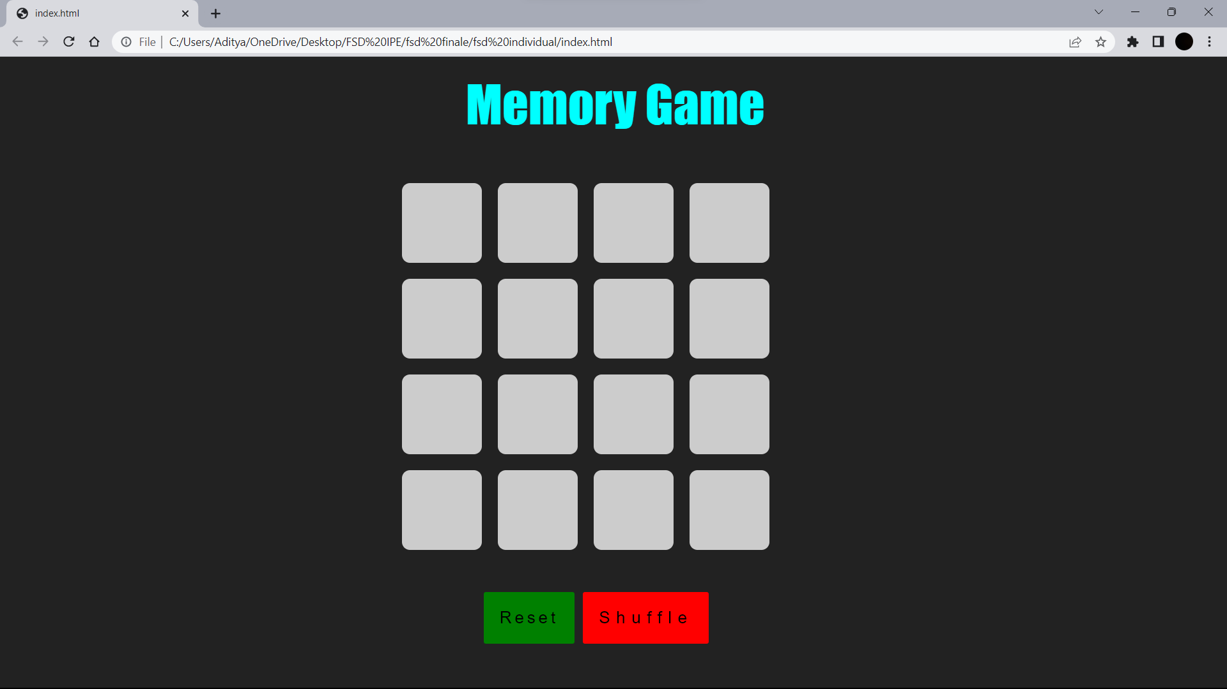
OUTPUT:

Slide 5
Advantages:
The code creates a functional memory game using HTML, CSS, and JavaScript.
The game board is created dynamically using JavaScript.
The code handles matching of the cards and keeps track of the cards that have been won.
The code implements shuffling of the cards.
The code includes a reset button to restart the game.

Slide 6
ThankYou!

